Slide 1
第四讲 类的概述

Slide 2
内容
类和对象
面向对象的特点
Overview of Classes
字段和方法的概述

Slide 3
类和对象
为什么要使用面向对象的方法编程？
  提高生产效率
  降低编程难度
  更专注于业务逻辑的开发

Slide 4
面向对象(Object-Oriented)的特点
封装性—最重要的特性
继承性
多态性

Slide 5
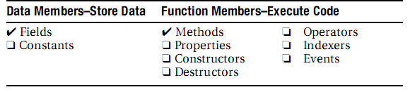
Overview of Classes
A class is the core of object-oriented programming.
A class is a data structure that can store data and execute code.
  Data members
  Function members

Slide 6
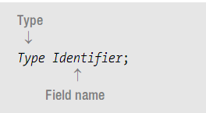
Field 字段
A field is a variable that belongs to a class.
Unlike C and C++, there are no global variables (i.e., variables or fields) declared outside of a type.
All fields belong to a type, and must be declared within the type declaration

Slide 7
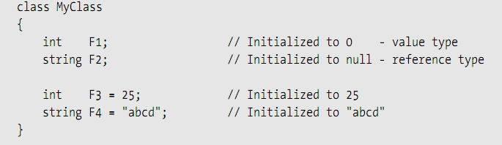
Explicit and Implicit Field Initialization

Slide 8
Methods 方法
Methods correspond to member functions in C++
Unlike C and C++, there are no global functions (i.e., methods or functions) declared outside of a type declaration.

Slide 9
Instance Members
Instance members: Each instance of a class is a separate entity that has its own set of the data members, distinct from the other instances of the same class.
Static members: Instance members are the default, but you can also declare members that are associated with the class, rather than the instance.

Slide 10
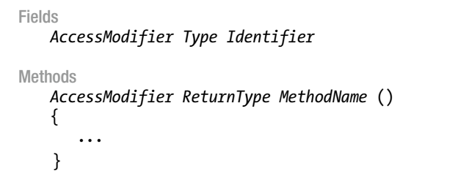
Access Modifiers
• private
• public
• protected
• internal
• protected internal

Slide 11
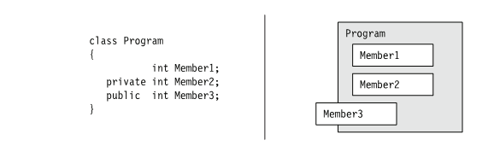
Access Modifiers

Slide 12
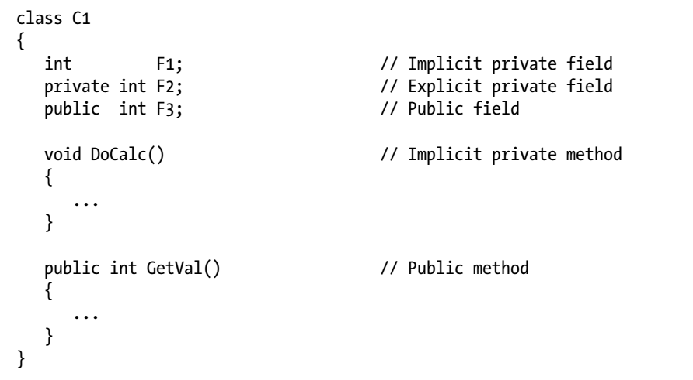
An Example
Demo

Slide 13
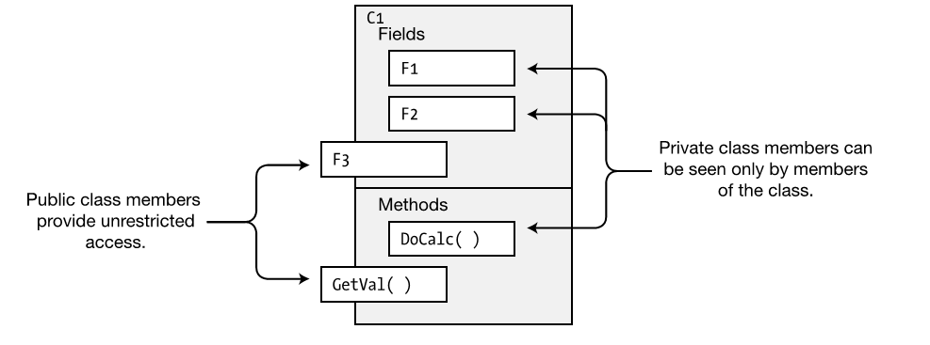

Slide 14
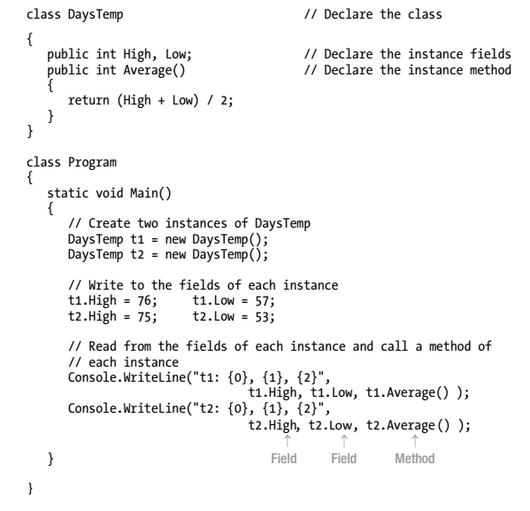
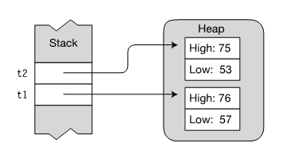
Memory layout of instances t1 and t2

Slide 15


终于
结束啦！

